Slide 1
Pneumovagina rectovaginal fistula
Asses. Prf. Dr. Rafid Majeed

Slide 2
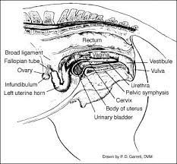
The caudal aspect of the reproductive tract is composed of
the vulva,
vestibule,
vagina
cervix.
These structures are susceptible to a variety of injuries during breeding and foaling.
Conformational abnormalities predispose the mare to pneumovagina, urovagina, and other problems. Ultimately, problems associated with the caudal reproductive tract can lead to infertility.

Slide 3
The external genitalia of the mare are composed of the perineum and the vulva.
The perineum is the region bound dorsally by the base of the tail and ventrally by the ventral commissure of the vulva.
The fibromuscular perineal body lies between the anus and the vulva.
Fibers of the external anal sphincter and the constrictor vulvae muscles form the perineal body

Slide 4
The vulva includes the two labia and the clitoris.
the labia of the vulva are vertical and meet dorsally to form the dorsal commissure, The labia meet ventrally to form the ventral commissure, which is located caudal and ventral to the ischial arch.
Normally, the labia of the vulva are muscular and resist manual separation, as a result of the paired constrictor vulvae muscles, which lie deep to the skin of the labia.
The clitoris in the mare is the homolog of the penis in the male. It is located at the ventral commissure of the vulvar labia.

Slide 5
The vestibule is the terminal part of the internal genital tract. it connects the vulva to the vagina.
The normal configuration of the vestibule is a ventrodorsal slope in the rostrad direction.
The cranial extent of the vestibule ends at the level of the transverse fold, which is located dorsal to the external urethral orifice.
The lateral and ventral surface of the vestibule is covered by the constrictor vestibuli muscles, which dorsally are incomplete. The paired constrictor vestibuli muscles blend caudally with the constrictor vulvae muscles.
The constrictor vestibuli muscles, the pillars of the hymen, and the floor of the pelvis meet to form the vestibular sphincter

Slide 7
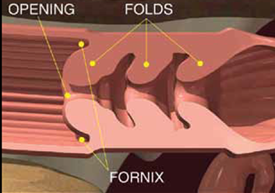
The vagina is a tubular structure extending cranially from the transverse fold of the external urethral orifice to the vaginal fornix around the cervix.
The cervix is an extension of the uterine body, with the caudal portion positioned in the cranial aspect (fornix) of the vagina.
The cervix is a tubular muscular structure lined with mucosa that forms many longitudinal folds. It functions as a sphincter, separating the caudal reproductive tract from the uterus.

Slide 8
There are essentially three protective barriers in the caudal reproductive tract.
the first barrier is the constrictor vulvae muscles of the labia,
the second is the vestibular sphincter,
the cervix is the third.
When any of these barriers becomes incompetent, contamination of the reproductive tract may occur and result in infertility.

Slide 9
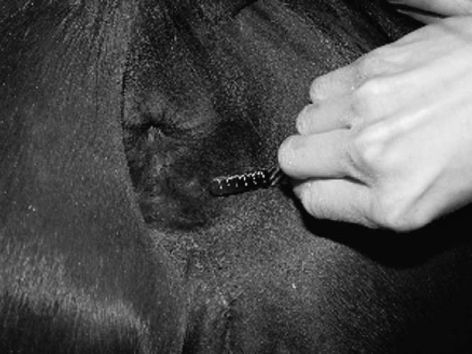
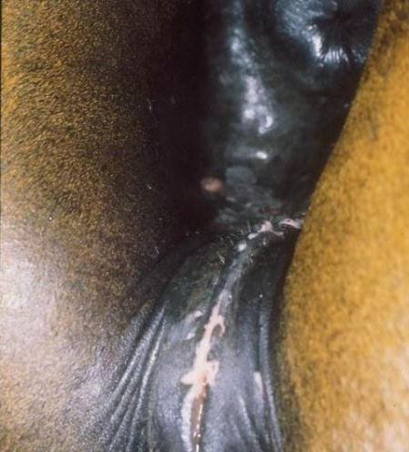
DISORDERS REQUIRING SURGERY
Pneumovagina
Pneumovagina leads to chronic inflammation and infection of the vagina and uterus and is one cause of infertility in the mare.
The most common cause of aspiration of air into the vagina is poor perineal conformation

Slide 10
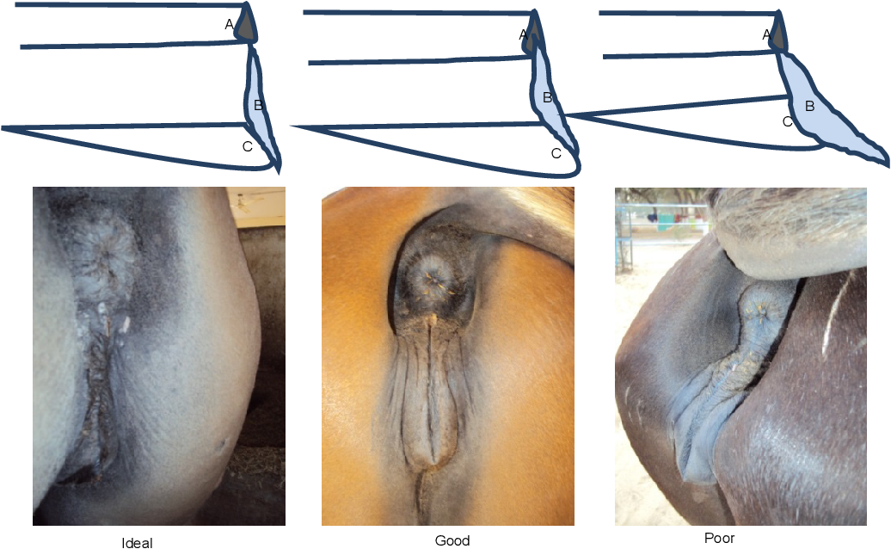
Pneumovagina may develop secondary to foaling trauma with scar tissue formation, excessive stretching of the vulvar tissues from foaling, or poor body condition
Sinking of the anus into the pelvic canal causes the dorsal commissure of the vulva to tip forward and have a horizontal orientation as opposed to vertical. This can disrupt the vulvar seal and lead to pneumovagina as well as fecal contamination of the caudal reproductive tract.

Slide 11
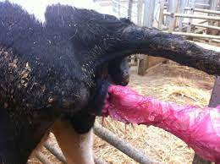
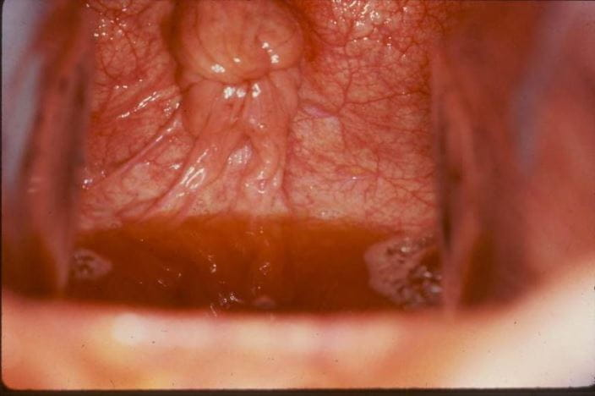
If manually separating the labia results in an inrushing of air, the mare is predisposed to pneumovagina. In some mares, pneumovagina occurs only during estrus when perineal tissues are more relaxed.
Urovagina can result from the same causes as pneumovagina, and the mare should be evaluated to determine if more than one surgical procedure is necessary.

Slide 12
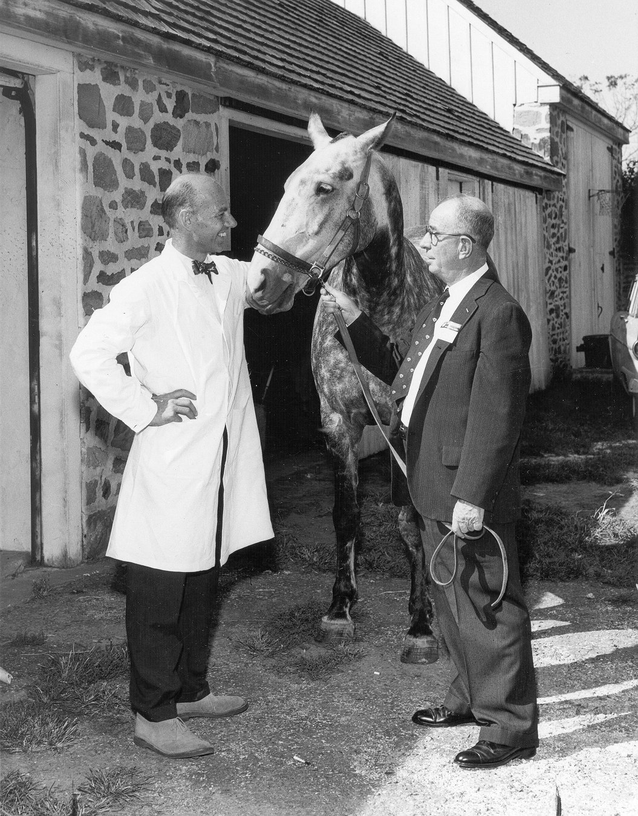
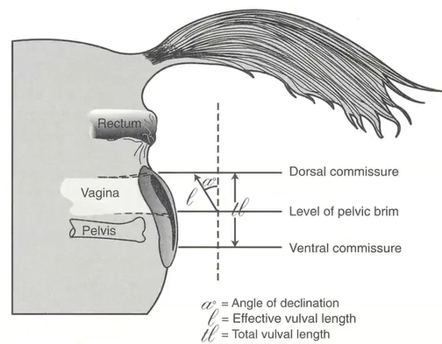
Episioplasty
CASLICK PROCEDURE
The most common surgical method for correction of pneumovagina is the Caslick procedure, first described in 1937.
The intent of this surgery is to form a seal to prevent aspiration of air or fecal material into the vestibule.

Slide 13
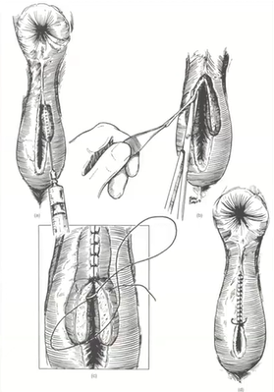
This is accomplished by incising the labia or excising a thin strip of tissue from the labial borders and then suturing the labia together.
Pneumovagina can be prevented in most cases by suturing the labia together to the level of the ventral border of the ischial arch. The ventral limit is determined by palpating the ischial arch just lateral to the opening of the vulva.

Slide 14
Alternatively, a scalpel can be used to incise the labia at the mucocutaneous junction rather than to excise any tissue. The incision must be of sufficient depth so that a tissue gap of 4 to 8 mm is achieved.

Slide 15
Closure is achieved using 2-0 absorbable or nonabsorbable suture material in a continuous pattern.
The sutures should be removed 10 to 12 days later, and the surgery site should be evaluated for fistula formation.
Because fistula formation can lead to aspiration of air and fecal material and negate the effects of the procedure, it should be repaired

Slide 16
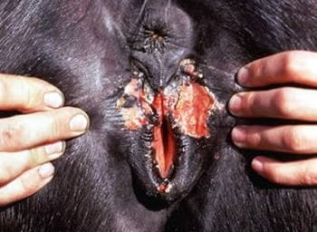
Excessive removal of tissue will make subsequent Caslick procedures more difficult because of fibrosis and loss of tissue, This may lead to dehiscence of a routine Caslick procedure. In such cases, a three-layer closure can be used.
The inner layer consists of the mucosa of the two labia, which is apposed using 2-0 absorbable suture material in a continuous horizontal mattress pattern.
Then, the constrictor vulvae muscles are apposed using 2-0 absorbable suture material in a similar pattern.
Finally, the cutaneous layer is apposed using 2-0 or 0 absorbable or nonabsorbable suture material in a continuous pattern.

Slide 17
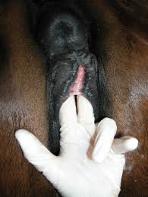
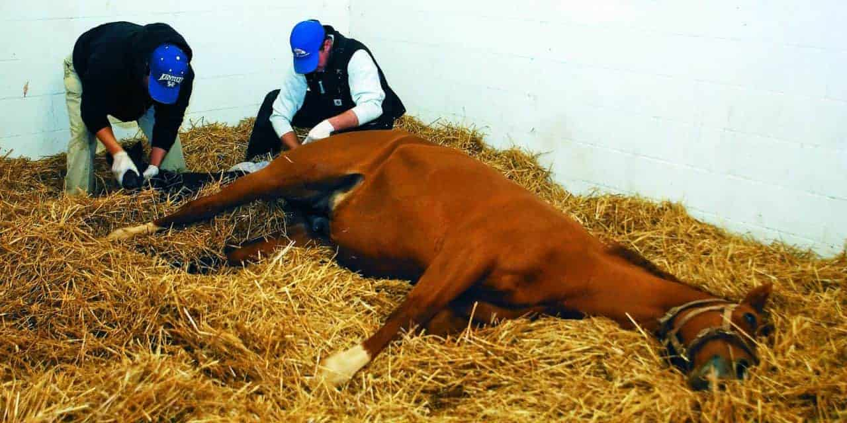
Urovagina may result from excessive closure of the vulvar cleft.
Closure is considered excessive if a tube speculum cannot be readily passed.
In mares that have had a Caslick procedure, an episiotomy should be performed 2 weeks prior to foaling to prevent damage to the vulva and perineum during the foaling process.

Slide 18
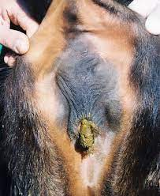
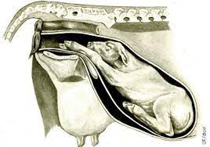
Rectovaginal Fistula Repair
Rectovaginal fistulas are not common in cattle but do occur in adults, secondarily to dystocia.
During parturition, the front foot of a calf in an anterior, dorsosacral presentation typically perforates the dorsal aspect of the vestibule and enters the rectum.
The foot is withdrawn and leaves a defect between rectum and vagina. Recto vaginal fistulas are also seen in calves with atresia of the anus, third-degree perineal laceration repair.

Slide 19
If the fistula was traumatic, adequate time (4 to 6 weeks) should be allowed before surgery because the defect size can be reduced markedly as a result of wound contraction. Some smaller defects have been reported to heal completely.
Another option is to repair the fistula primarily. With adequate restraint and preparation, a transverse incision is made between the rectum and vagina. By using a combination of sharp and blunt dissection in a horizontal plane, the fistula is exposed.

Slide 20
Ideally, 2/3 of the thickness of the shelf should be with the rectum and 1/3with the vaginal shelf. Most fistulas measure 3 to 5 cm. Dissection is continued 3 to 4 cm rostral to the fistula.
The rectal defect is closed transversely by using number 0 or I absorbable sutures in a simple interrupted pattern placed in the submucosa, with care taken not to penetrate the rectal mucosa. The first suture should divide the defect in half; the next two sutures should be placed to bisect the halves, and so on. Alternatively, one can prep lace the sutures.
In addition, successful repairs have been reported with longitudinal closure of the rectum. Either technique is adequate if there is good tissue apposition with little tension.

Slide 21
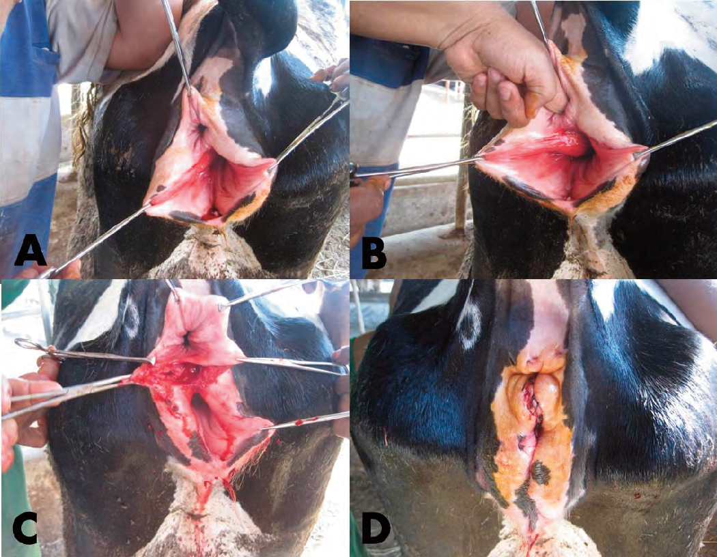

Slide 22
The vaginal defect is closed next. Many advocate a continuous horizontal mattress pattern in a longitudinal direction so that the two suture rows are at right angles to each other and the vaginal mucosa is everted. The incised perineal body is closed with multiple interrupted sutures of 2-0 suture; the skin is closed routinely.
Complications include dehiscence or fistula formation.

Slide 23
TUMORS OF THE VAGINA AND CERVIX
Smooth muscle tumors are the most common tumors of the vagina and cervix of farm animals and occur in adult cattle, goats and pigs. These tumors are rare in sheep
Papilloma, fibropapilloma, and lymphoma can also involve the vagina and cervix, especially in cattle. Fibroma also occurs in the vagina of pig

